Slide 1

Airbnb Price Optimization: A Data-Driven Strategy for NYC Hosts
Siva Prakash S
INTERNSHIP_17546440516895be537820f

Slide 2

PROBLEM STATEMENT
In the competitive short-term rental market, hosts face the critical challenge of optimizing property pricing to maximize both revenue and occupancy. The prevalent reliance on static, intuition-based pricing strategies creates a significant opportunity cost. This leads to unrealized revenue and makes it difficult to maintain a competitive edge. The result is a less efficient market for both hosts and the platform.

Slide 3
Project Description
This project provides a data-driven solution for Airbnb hosts in New York City to optimize their rental pricing. By analyzing a comprehensive dataset, it moves beyond intuitive pricing to identify key factors influencing cost, such as location, property type, and market demand. Through data cleaning and exploratory analysis, the project generates clear visualizations that reveal pricing patterns and correlations. The result is a set of actionable insights, empowering hosts to set competitive prices that maximize revenue and occupancy rates.

Slide 4

WHO ARE THE END USERS?
Primary Users (Direct Beneficiaries):
Individual Airbnb Hosts: Property owners seeking to maximize their rental income.
Professional Property Managers: Companies managing multiple listings that require a standardized, data-backed pricing model.
Secondary Users (Strategic Stakeholders):
Real Estate Investors: Individuals analyzing the market to find profitable investment properties for short-term rental.
Airbnb's Internal Teams: Data science and strategy teams looking to refine platform-wide pricing tools and understand host behavior.

Slide 5

Technology Used
Language: Python
Environment: Google Colab
Core Libraries:
Pandas: For data manipulation, cleaning, and preprocessing.
Matplotlib & Seaborn: For creating static, interactive, and informative statistical visualizations.
Warnings: For script management.

Slide 6
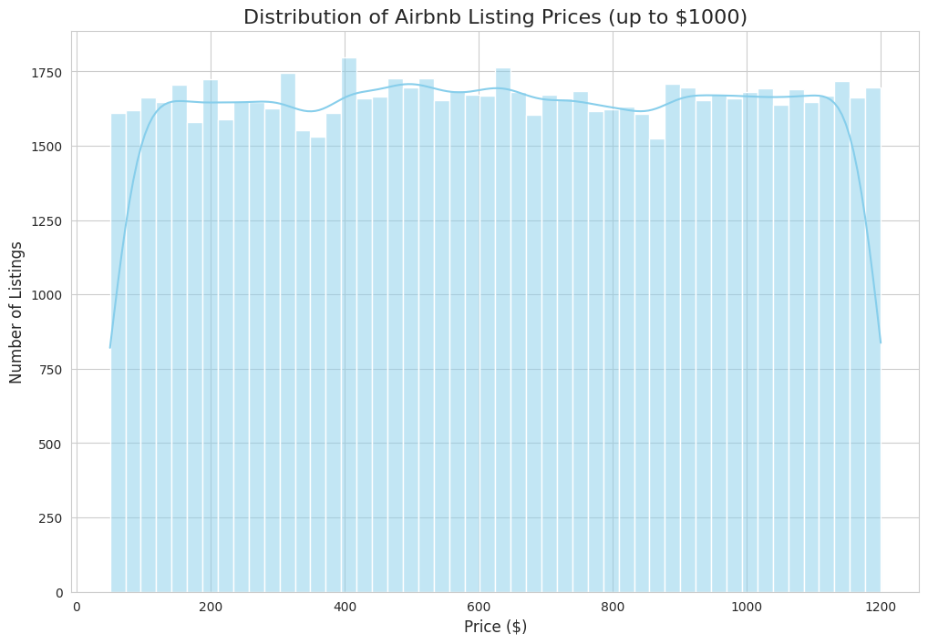
RESULTS1

Slide 7
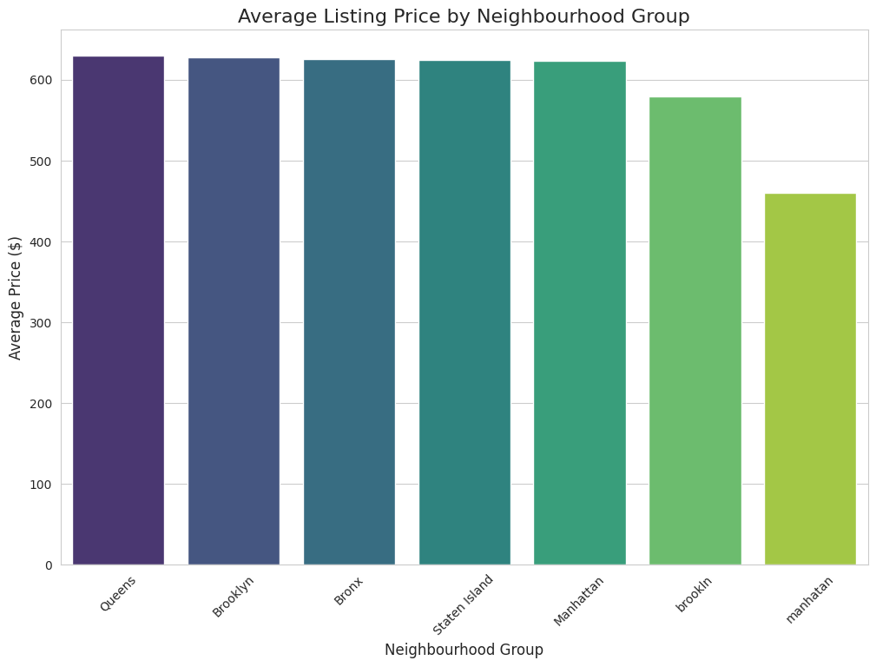
RESULTS2

Slide 8
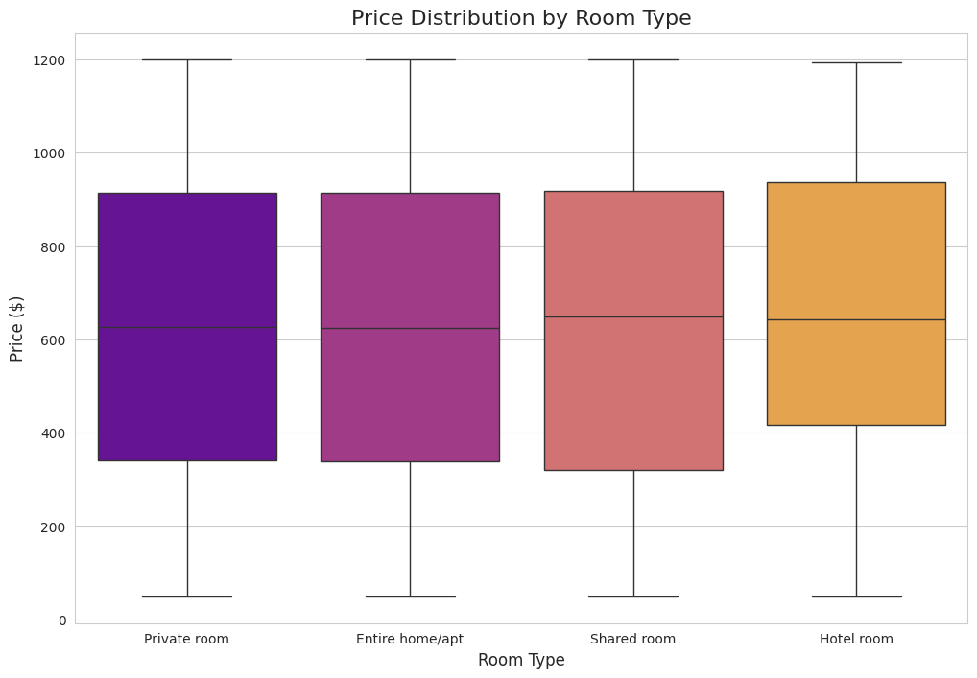
RESULTS3

Slide 9
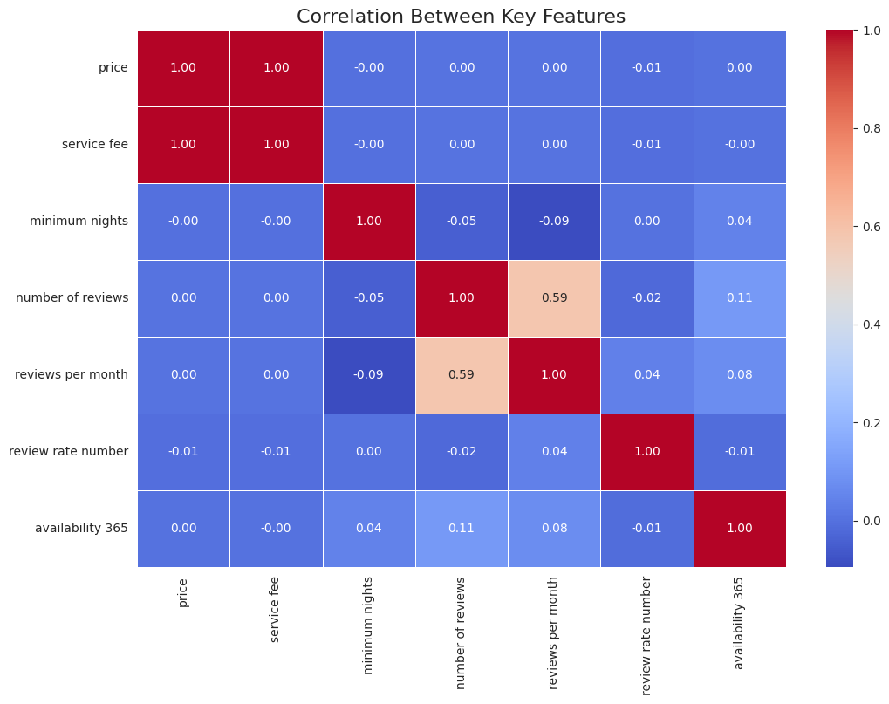
RESULTS4

Slide 10
GitHub repository
https://github.com/SivaPrakash-2715/VOIS_AICTE_Oct2025_Siva-Prakash.git
Demo Link

Slide 11
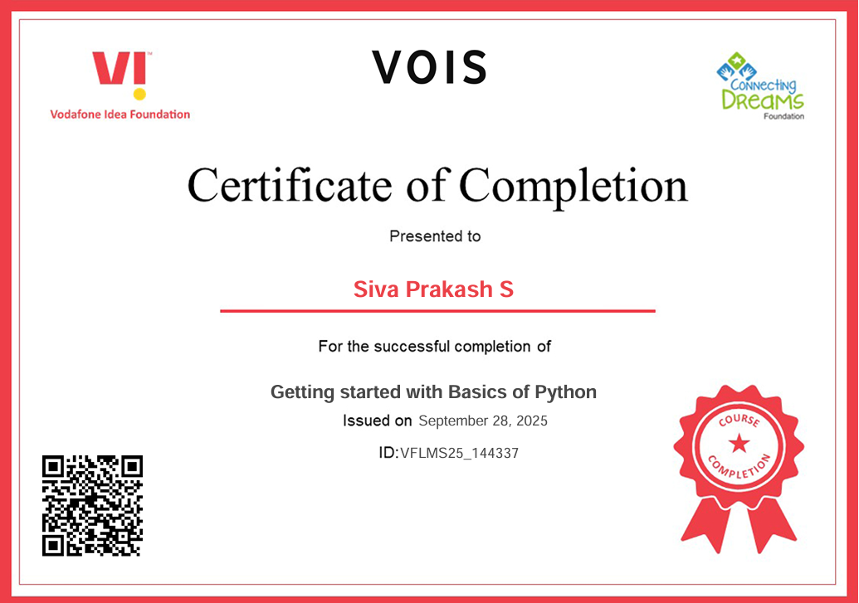
Getting started with Basics of Python Certificate

Slide 12
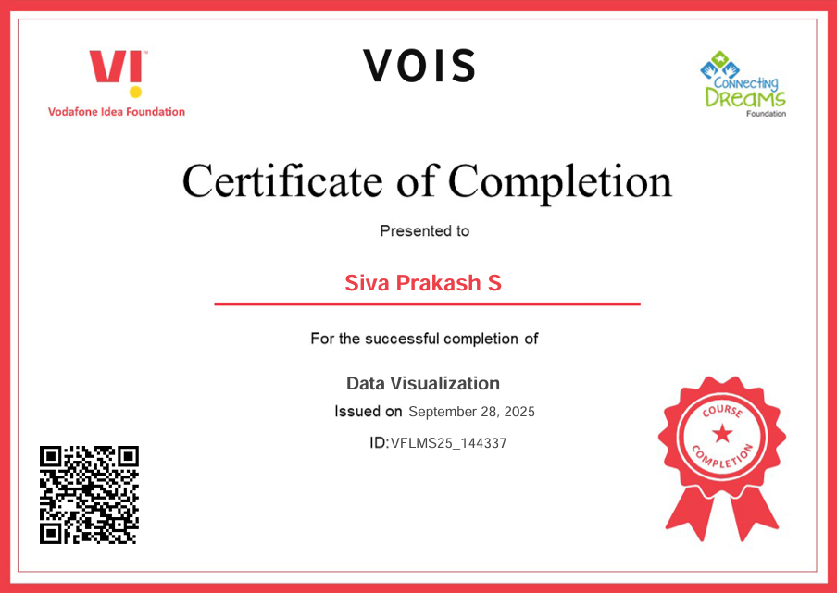
Data Visualization Certificate

Slide 13
Thank you
.
.

